Slide 1
A Swimming Fish
0856706 Susan Ku

Slide 2

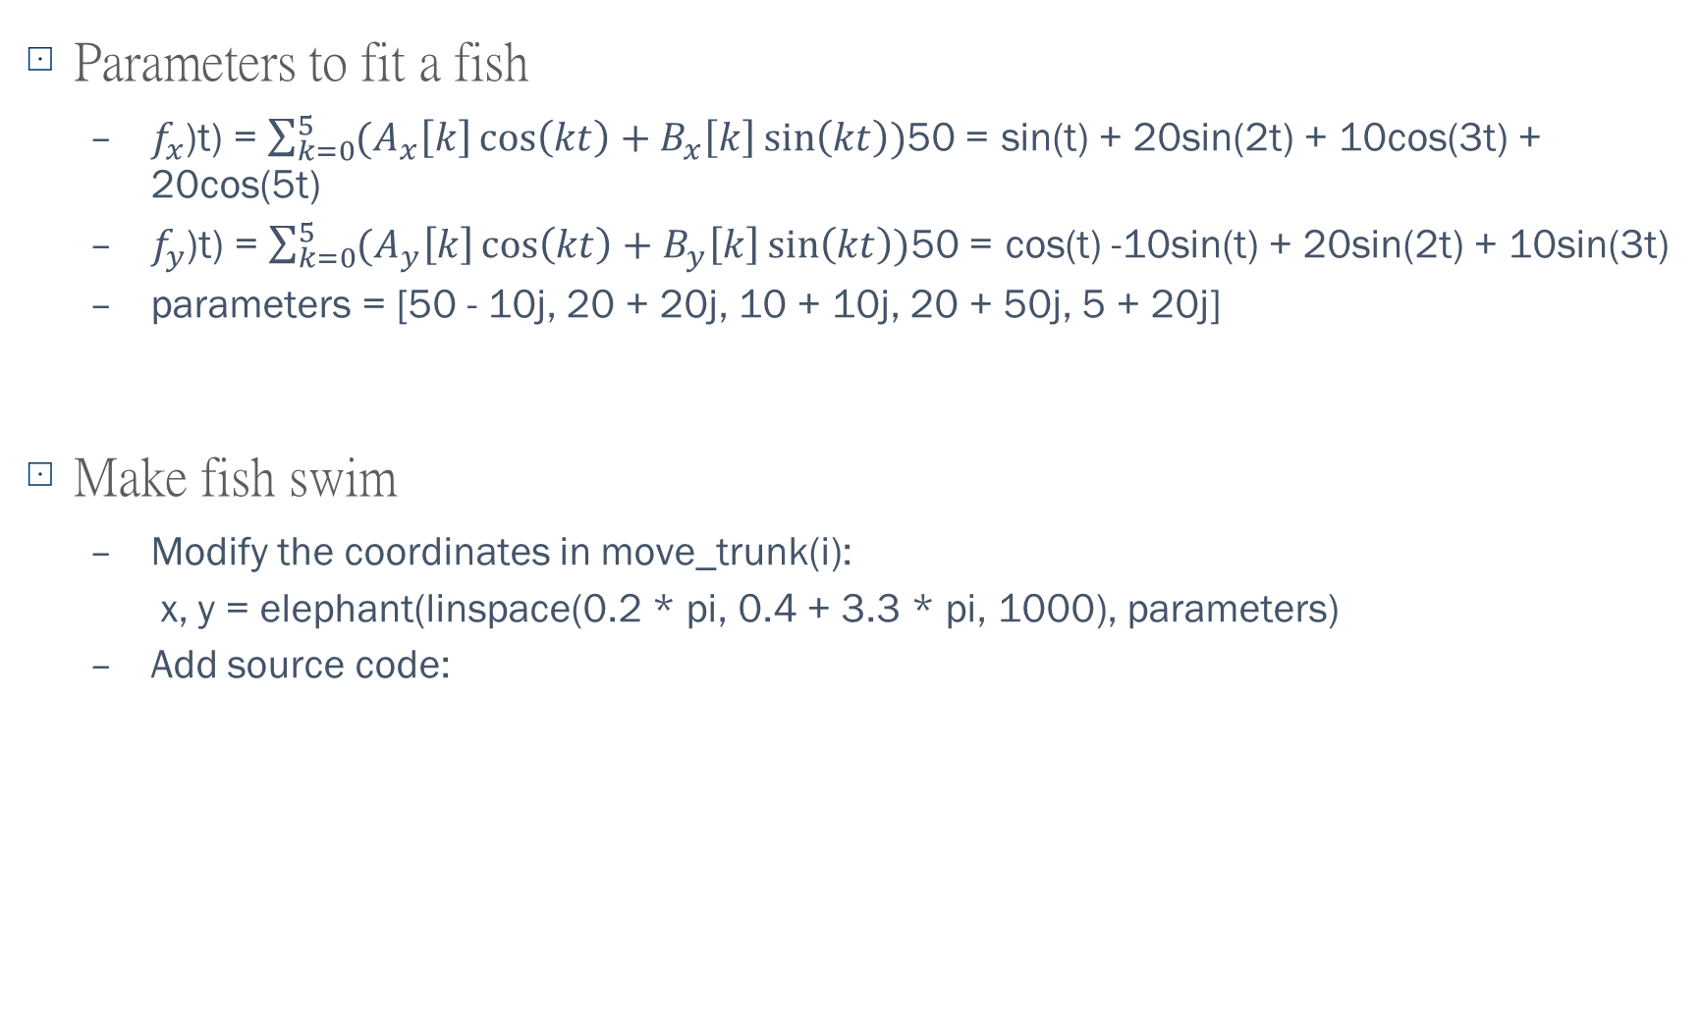
Explanations of changes in source code
Parameters to fit a fish
$f_{x}$(t) = $\sum_{k=0}^{5}{(A_{x}\left[k\right]\cos\left(kt\right)+B_{x}\left[k\right]\sin\left(kt\right))}$ = 50sin(t) + 20sin(2t) + 10cos(3t) + 20cos(5t)
$f_{y}$(t) = $\sum_{k=0}^{5}{(A_{y}\left[k\right]\cos\left(kt\right)+B_{y}\left[k\right]\sin\left(kt\right))}$ = 50cos(t) -10sin(t) + 20sin(2t) + 10sin(3t)
parameters = [50 - 10j, 20 + 20j, 10 + 10j, 20 + 50j, 5 + 20j]
Make fish swim
Modify the coordinates in move_trunk(i):
x, y = elephant(linspace(0.2 * pi, 0.4 + 3.3 * pi, 1000), parameters)
Add source code:

Slide 3
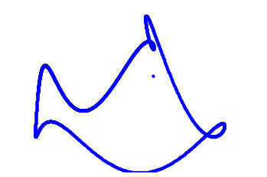
Results
Image:
Animation: https://github.com/susansfku/SDA_2020Class_Susan/blob/main/HW1_WiggleAnimal/fish_wiggle.mp4

